Slide 1
Project1
Part1 & Part2 Theme3
Boshen Zhang, Yuchuan Dong, Yuwei Shi, Shijia Tang, Fanze Meng
2024/4/17

Slide 2
Basic Setups & Analysis for Part1
3 Key things to cover in this project:
Training size (25%, 50%, 75%)
Classifier choices (KNN, Decision tree, SVC)
Rigid & Flexible
For KNN method, this is represented by the #neighbors
Decision tree: max number of trees
SVC: Penalty K
Basement for PCA & Feature Selection: Cross Validation
Analytical tools: Visualization

Slide 3
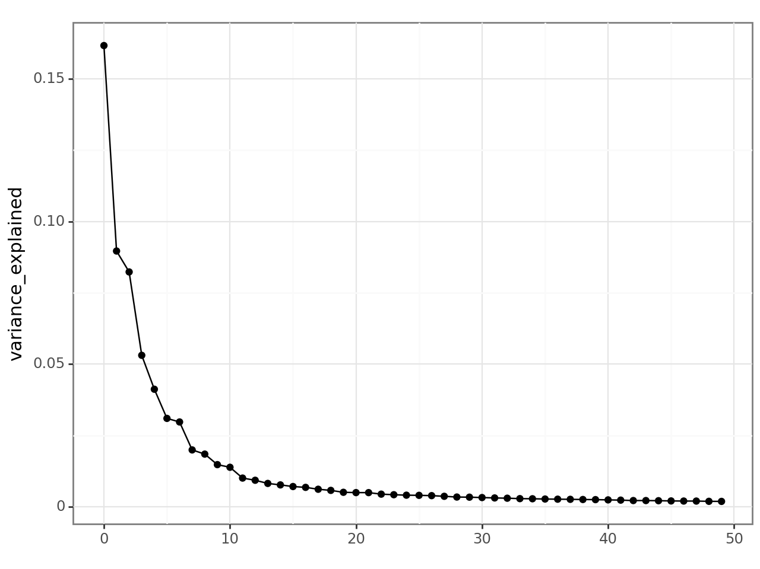
PCA
A total number of 2000 principle components can be generated in the dataset.
The only thing that matters to a principle is the variance explained.
We can limit the search range of principal components to the first 30

Slide 4
Feature Selection & Next Step
Similarly, we limit the search range of features to the top 100 features based on F-test.
After determining the range, we calculate the cross validation score and use it to find the optimal principal components/features
After PC/Features is decided, we calculate three quantities to evaluate its performance.

Slide 5
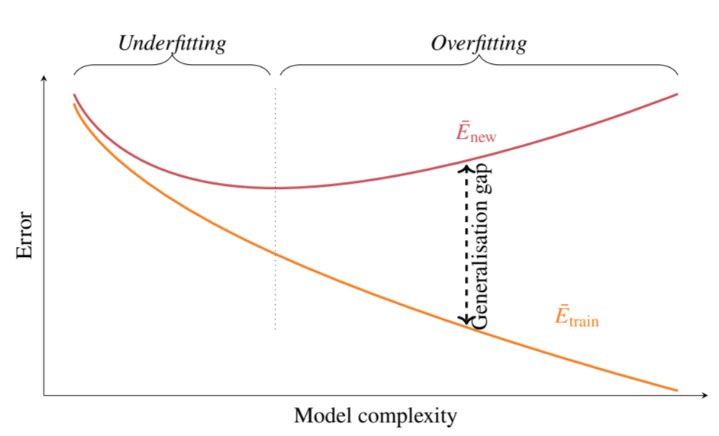
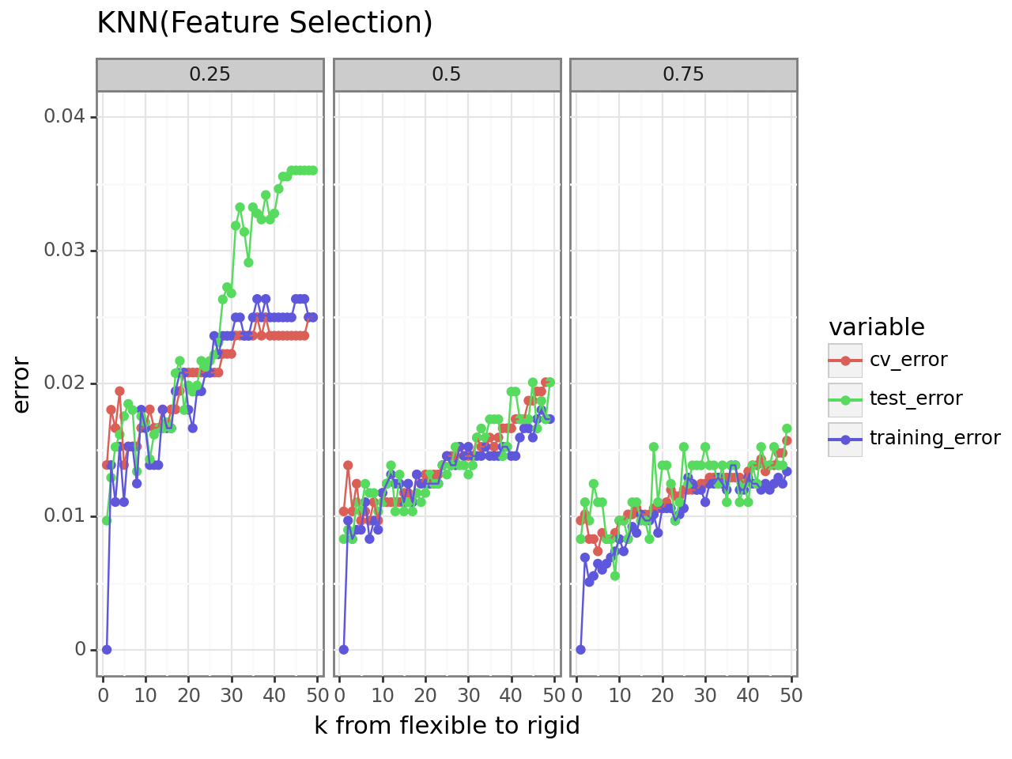
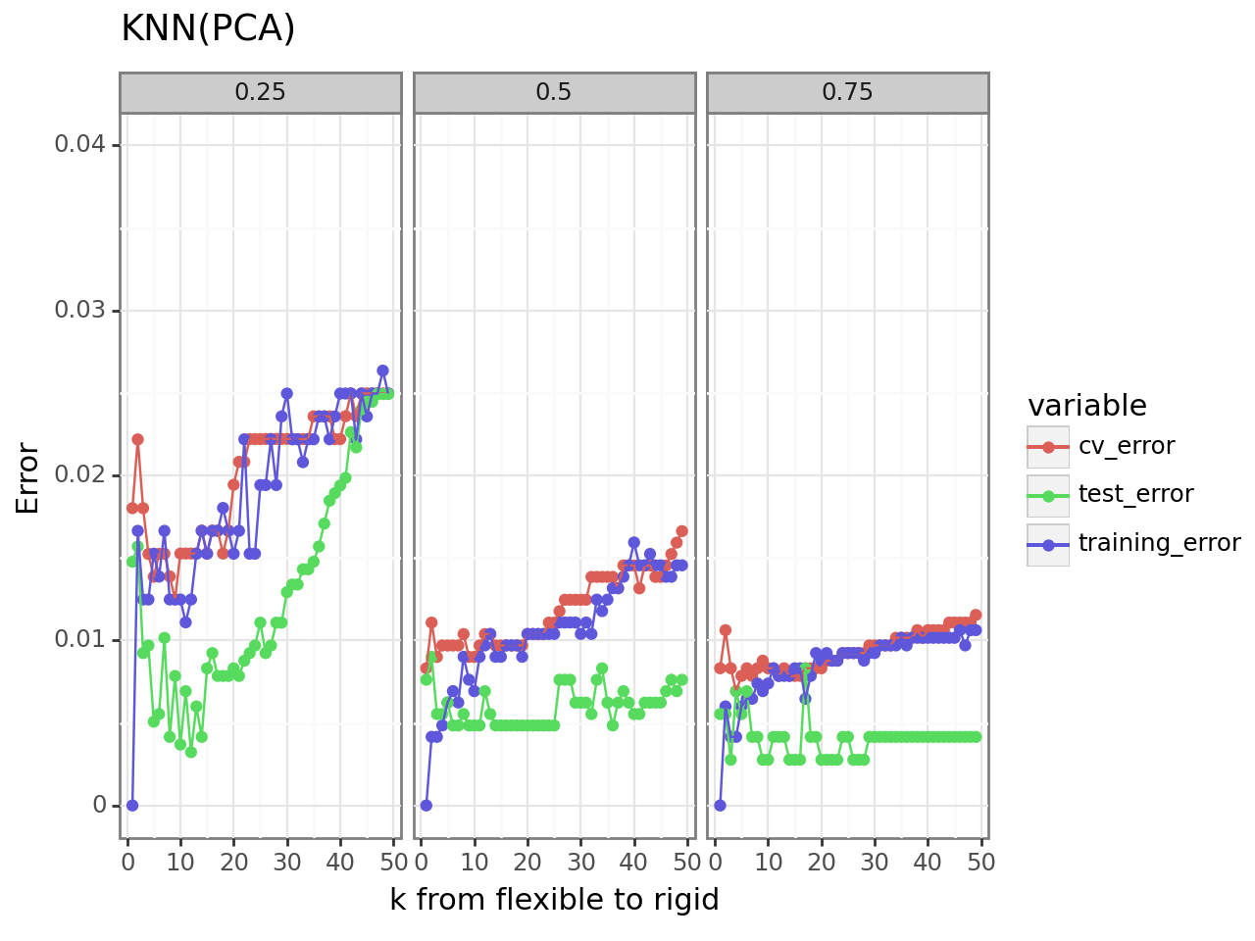
K-nearest Neighbors
Larger training size leads to better model performance.
Too flexible models tend to overfitting, while too rigid ones tend to underfit.
The similarity between cross-validation error and test error for that they both work on the unseen data classification (Same nature).

Slide 6
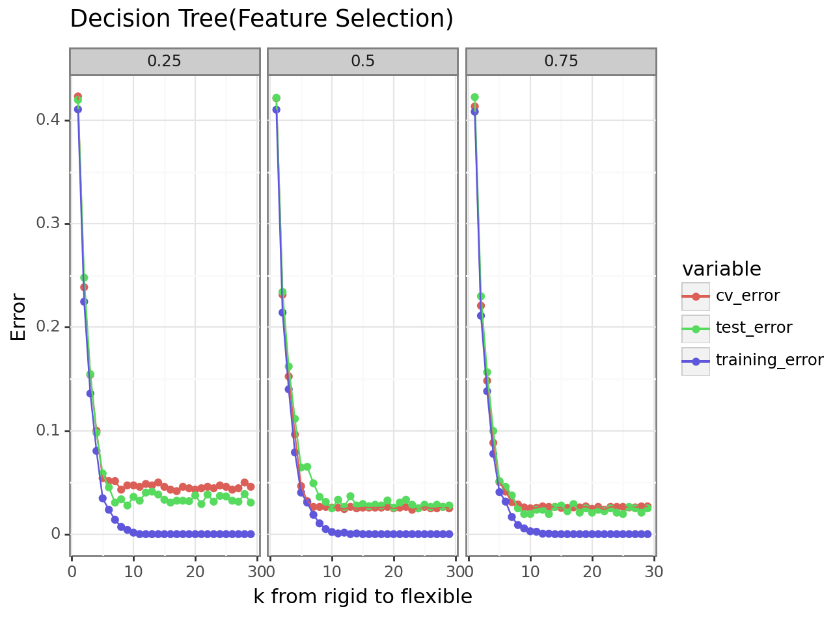
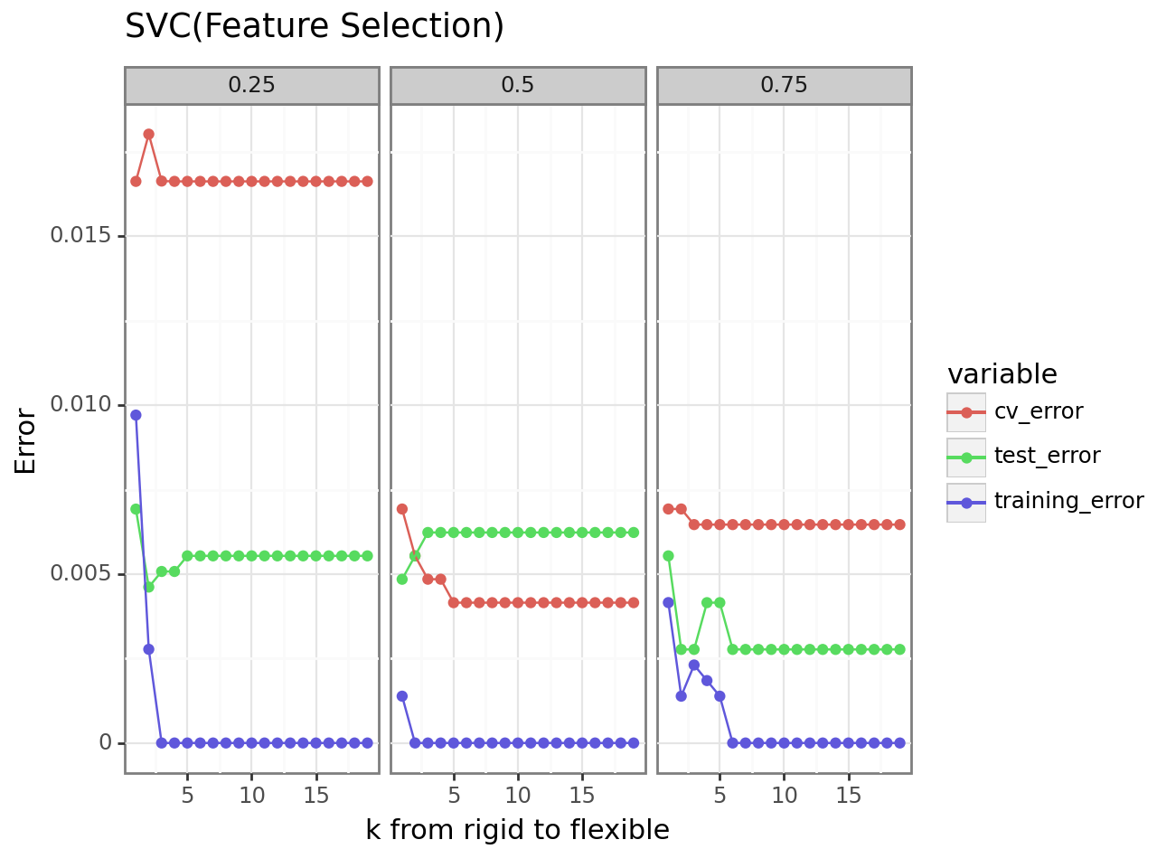
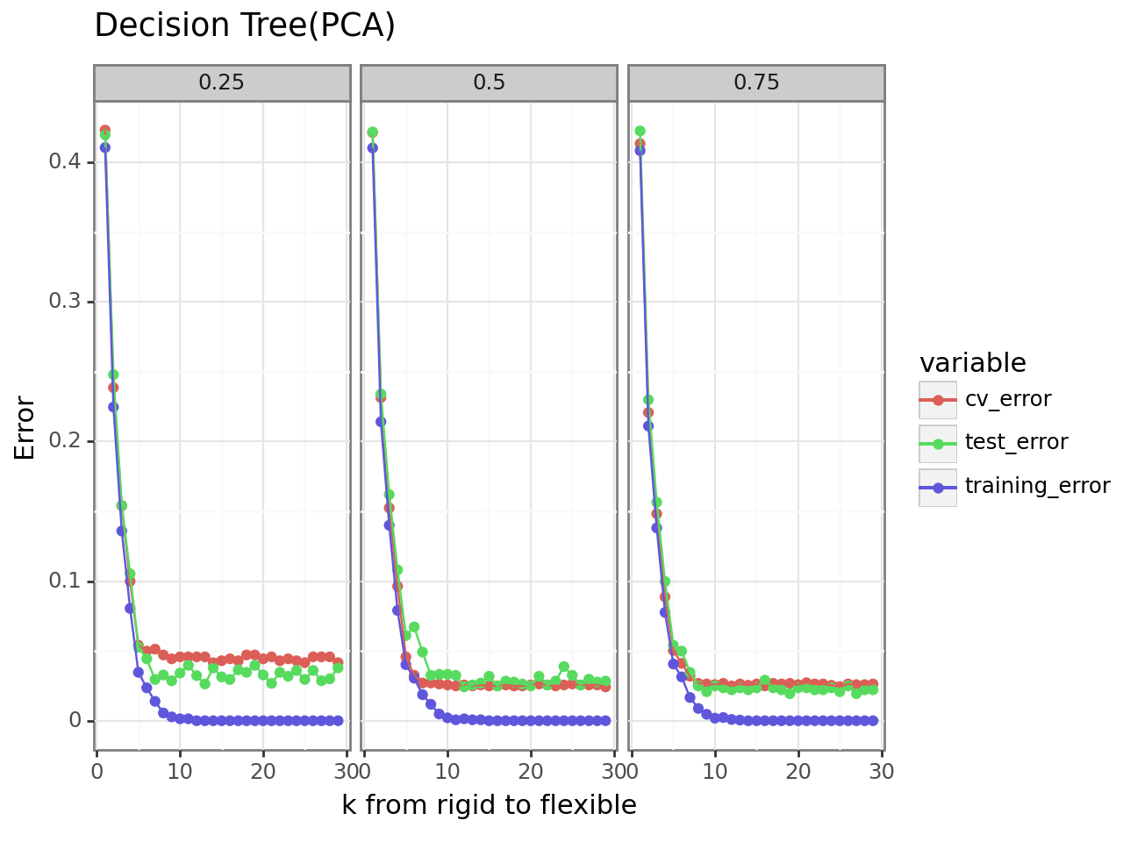
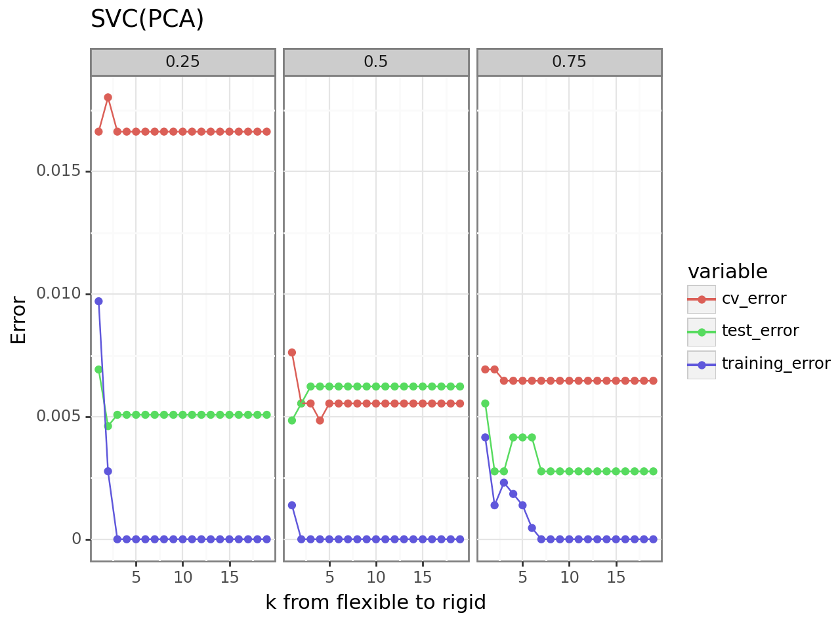
Decision Tree & SVM
In Decision Tree model, use Maximum depth as hyperparameters.
In SVM model, Use regularisation parameter as hyperparameter.
In Decision Tree model, the training error goes to 0 with model be flexible.
There is enough ‘feature’ to support model to select. The model will finally choose satisfied ‘feature’ to classify.
In SVM model, the training error also goes to 0 with model be rigid.
When model be flexible, the model can’t tolerate error, model need more ‘feature’ to reduce the error. Luckily, cv will always find enough ‘feature’ to reduce the error in training set.
Difference between KNN
Significant overfitting and underfitting are usually less easily observed. (Prune and regularisation)

Slide 7
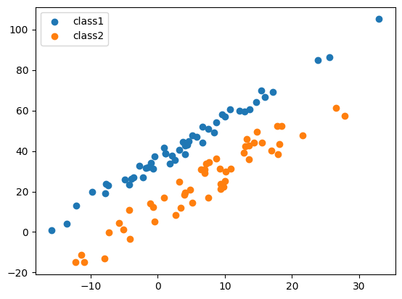
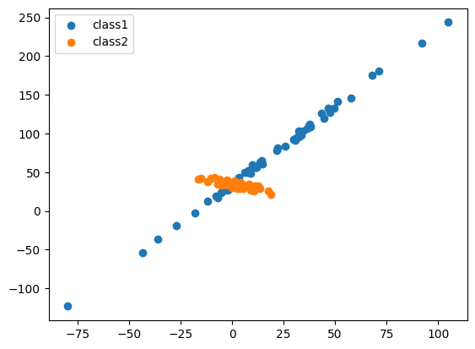
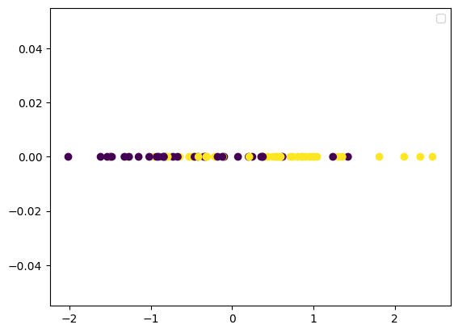
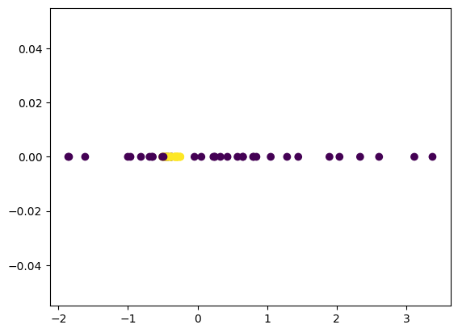
Voluntary: Constructed dataset
PC1
PC1
figure(1): ‘Bad’ dataset leads to PCA failed
figure(2): ‘Good’ dataset leads to PCA success
figure(3): ‘Good’ dataset projection along with PC1 axis
figure(3): ‘Bad’ dataset projection along with PC1 axis
Before applied PCA, The accuracy of Logistic Regression classifier: 0.76
After applied PCA, The accuracy of Logistic Regression classifier: 0.86
Before applied PCA, The accuracy of Logistic Regression classifier: 1
After applied PCA, The accuracy of Logistic Regression classifier: 0.7

Slide 8
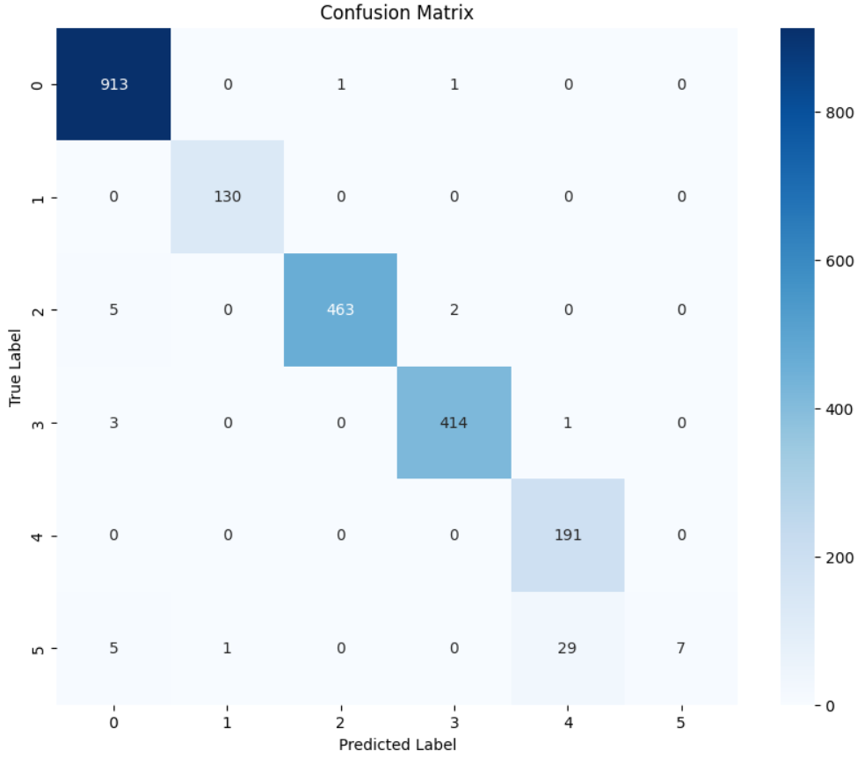
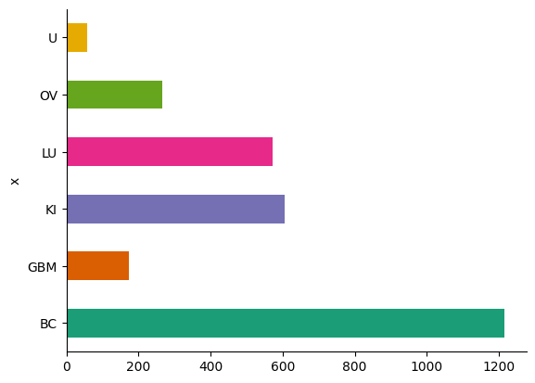
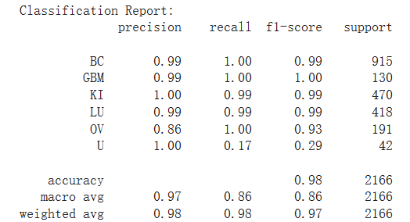
Other performance metrics to address imbalance problem
The data imbalance
Train size = 0.25; k = 45; PC = 10
To ensure comparability among solutions based on different metrics for identifying the best principal component (PC), we use accuracy as the final performance metric.

Slide 9
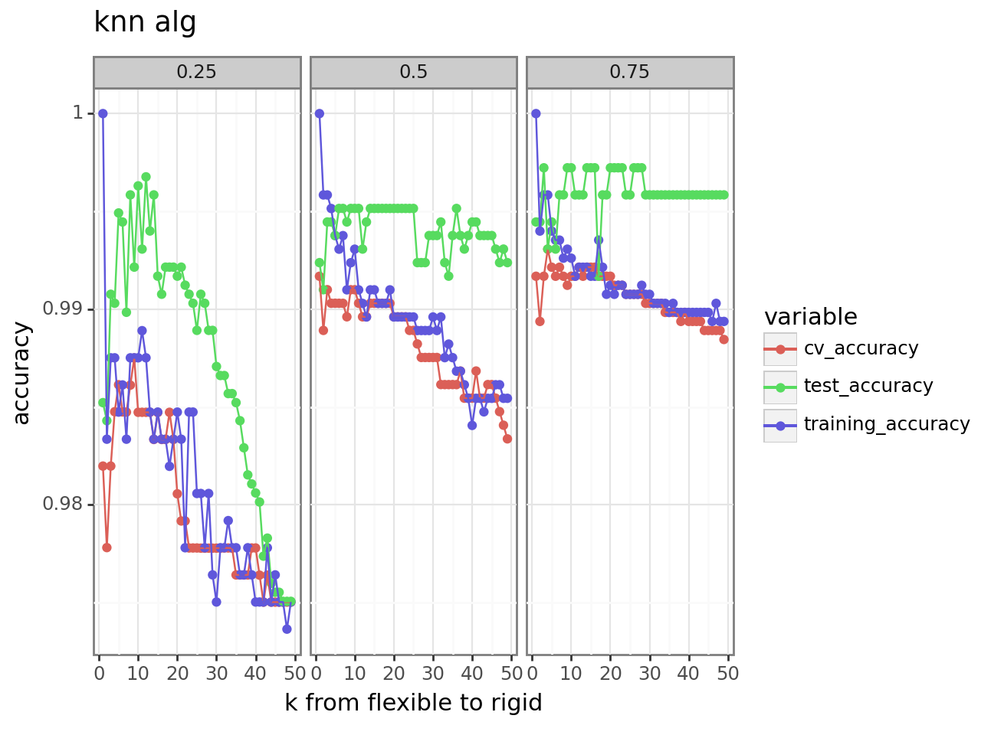
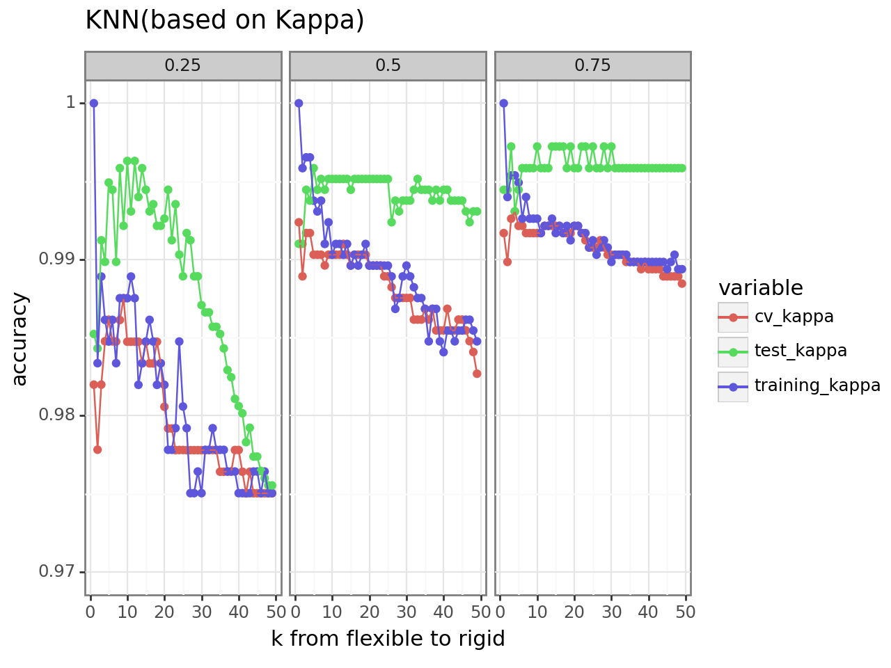
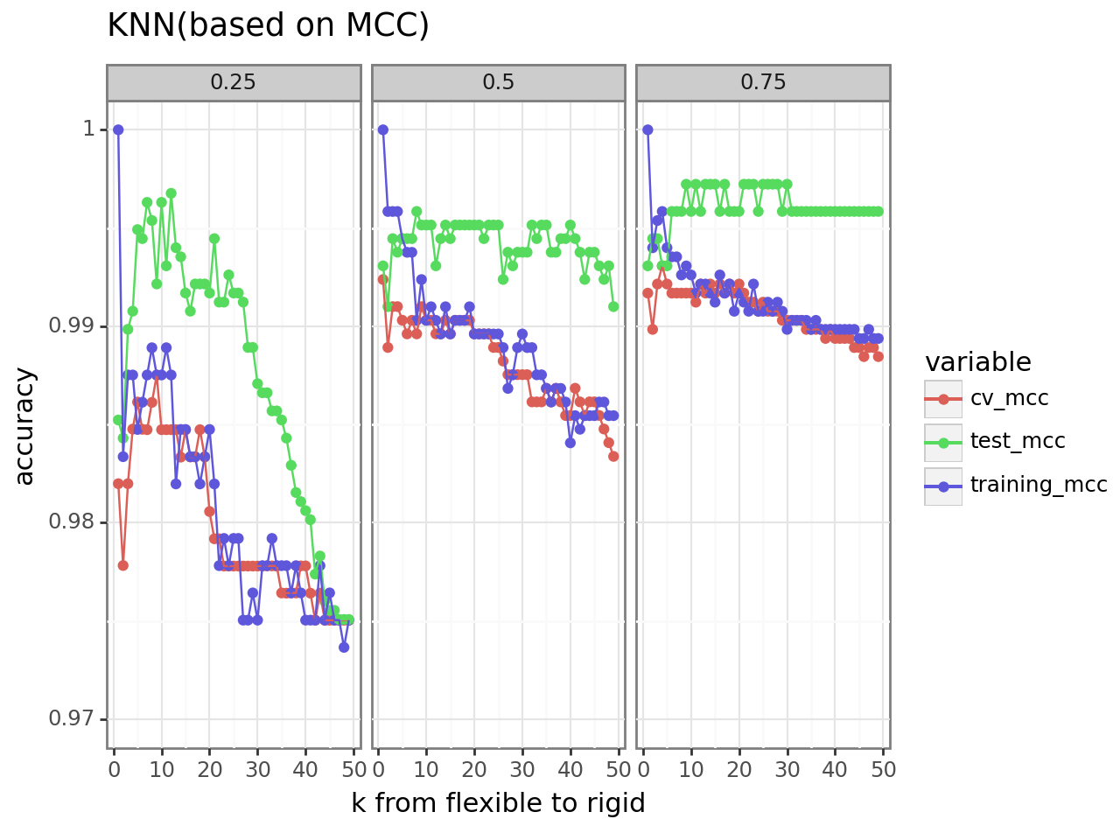
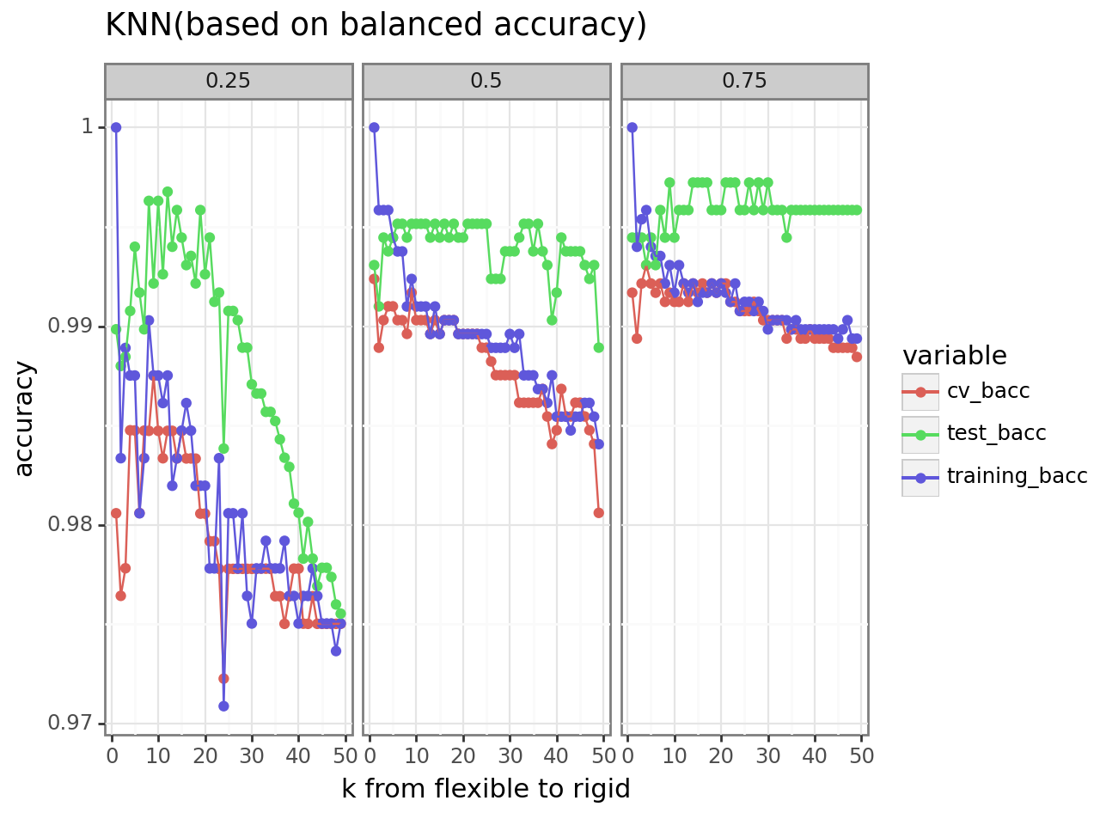
Select PC Using different performance metrics
The situation in balanced accuracy is similar to the original one.
The cv error become slightly bigger after using Kappa and MCC as performance metrics
The test error become smaller and more stable after using Kappa and MCC as performance metrics.

Slide 10
Summany
Main results:
Connection between model flexibility and over/underfit.
Training size matters, for high-dimensional problem, big enough training set is needed for the model to retrieve enough informations for training.
Different choices of performance metric can improve the performance for unbalanced data.
Challenges:
The optimization problem for finding the best PCs can rely on variance to narrow down “domain”. However, for feature selection, there is a lack of relevant simple enough theoretical basis, the non-orthogonality between features also makes it harder.
Limitations:
Only explored how other metrics could effect on finding best PCs and selection of features.
Only explored limited number of classifiers.
Take home messages:
Different methods may have very different performances and need to be selected based on different data situations.

